Slide 1
Effective Language and Communication Skills (Course Code: HS1000)
Instructor: Dr. Kandharaja K M C

Slide 2
Brainstorming
What is your expectation from this course?

Slide 3
Brainstorming
What is communication?

Slide 4
Brainstorming
Can you specify the types of communication (spoken & written) students are expected do in higher education?

Slide 5
Brainstorming
What are the benefits of effective communication? Provide examples.

Slide 6
Objective of the course
Hone LSRW and practice critical thinking
Enable students to speak and write grammatically acceptable sentences
Train students in technical communication
Cultivate interest to learn language and to build the confidence to communicate in English
Develop an interest in updating their language skills through continuous learning
Connecting personal growth with improvement in their proficiency in English

Slide 7
Major components of the course
Speaking
Reading
Writing
Listening
Pronunciation
Grammar and Vocabulary

Slide 8
Attendance Policy
Minimum: 85%
Students with attendance less than 85% has to repeat the course.
No concessions in attendance will be provided at the end of the course.

Slide 9
Evaluation Scheme
60% Internal
40% End-semester exam

Slide 10
Self evaluation
Individual activity

Slide 11
When people speak English to you, how much do you understand?
Check the amount.
___ everything
___most
___some
___a little
___very little

Slide 12
When you watch TV, how much do you understand?
Check the amount.
___ everything
___most
___some
___a little
___very little

Slide 13
When you speak English, how much do other people understand?
Check the amount.
___ everything
___most
___some
___a little
___very little

Slide 14
Order the skills that you need from 1 to 6. Number 1 is the most important and number 6 is the least important to you at this time. Please use each number only one time.
___ Reading
___ Writing
___ Listening
___ Speaking
___Vocabulary
___ Pronunciation

Slide 15
Question
What specific areas of English would you like to improve in this course?
Please be specific. Give examples of situations that are difficult for you in English.

Slide 16
Activity: My life in five sentences.
Take a sheet of paper. Write five sentences about interesting things you have done in your life.
Time: 10 mins

Slide 17
Editing
Reread your sentences
Make necessary corrections
Time: 5 mins

Slide 18
Group work
Divide into group of five (5).

Slide 19
Exchange your group’s write ups with a other group.
Procedure
Step 1: Exchange your group’s write ups with a other group
Step 2: Read all the other group’s write ups individually (10 mins)
Step 3: Discuss and summarize the content of other group’s write ups (10 mins)
Step 4: Teacher will ask one from each group to orally summarize the points (20 mins)

Slide 20
Individual activity
People | Descriptor 1 | Descriptor 2 | Descriptor 3
Parents
Friends
Self

Slide 21
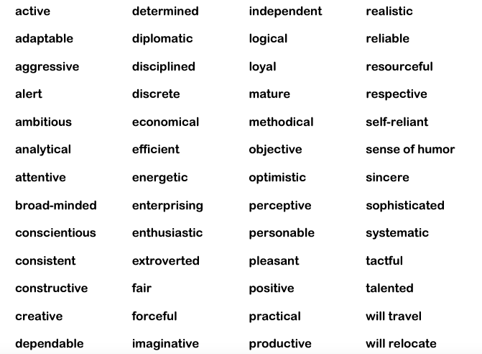
Read the words

Slide 22
Individual activity
People | Descriptor 1 | Descriptor 2 | Descriptor 3
Parents
Friends
Self

Slide 23
Self introduction
Name
Place
Mother tongue
Passion/Interest
Mention three positive qualities about you
Goals in life

